Slide 1

Open source Technologies Lab

Slide 2
HTML5 − Overview
HTML5 is the next major revision of the HTML standard superseding HTML 4.01, XHTML 1.0, and XHTML 1.1. HTML5 is a standard for structuring and presenting content on the World Wide Web.
HTML5 is a cooperation between the World Wide Web Consortium (W3C) and the Web Hypertext Application Technology Working Group (WHATWG).
The new standard incorporates features like video playback and drag-and-drop that have been previously dependent on third-party browser plug-ins such as Adobe Flash, Microsoft Silverlight, and Google Gears.

Slide 3
New Features
HTML5 introduces a number of new elements and attributes that can help you in building modern websites. Here is a set of some of the most prominent features introduced in HTML5.
New Semantic Elements: These are like <header>, <footer>, and <section>.
Forms 2.0: Improvements to HTML web forms where new attributes have been introduced for <input> tag.
Canvas: This supports a two-dimensional drawing surface that you can program with JavaScript.
Audio & Video: You can embed audio or video on your webpages without resorting to third-party plugins.
WebSocket : A next-generation bidirectional communication technology for web applications.
Server-Sent Events: HTML5 introduces events which flow from web server to the web browsers and they are called Server-Sent Events (SSE).
Geolocation: Now visitors can choose to share their physical location with your web application.
Microdata: This lets you create your own vocabularies beyond HTML5 and extend your web pages with custom semantics.
Drag and drop: Drag and drop the items from one location to another location on the same webpage.

Slide 4
Backward Compatibility
HTML5 is designed, as much as possible, to be backward compatible with existing web browsers. Its new features have been built on existing features and allow you to provide fallback content for older browsers.
It is suggested to detect support for individual HTML5 features using a few lines of JavaScript.

Slide 5
HTML Syntax
The DOCTYPE
DOCTYPEs in older versions of HTML were longer because the HTML language was SGML based and therefore required a reference to a DTD.
HTML 5 authors would use simple syntax to specify DOCTYPE as follows:
The above syntax is case-insensitive.

Slide 6
HTML Syntax
Character Encoding
HTML 5 authors can use simple syntax to specify Character Encoding as follows:
The above syntax is case-insensitive.

Slide 7
HTML Syntax
The <script> tag
It's common practice to add a type attribute with a value of "text/javascript" to script elements as follows
HTML 5 removes extra information required and you can use simply following syntax

Slide 8
HTML Syntax
The <link> tag
So far you were writing <link> as follows
HTML 5 removes extra information required and you can simply use the following syntax

Slide 9
HTML5 Elements
HTML5 elements are marked up using start tags and end tags. Tags are delimited using angle brackets with the tag name in between.
The difference between start tags and end tags is that the latter includes a slash before the tag name.
Following is the example of an HTML5 element
HTML5 tag names are case insensitive and may be written in all uppercase or mixed case, although the most common convention is to stick with lowercase.
Most of the elements contain some content like <p>...</p> contains a paragraph. Some elements, however, are forbidden from containing any content at all and these are known as void elements. For example, br, hr, link, meta, etc.
A complete list of HTML5 Elements (https://www.tutorialspoint.com/html5/html5_tags.htm)

Slide 10
HTML5 Attributes
Elements may contain attributes that are used to set various properties of an element.
Some attributes are defined globally and can be used on any element, while others are defined for specific elements only. All attributes have a name and a value and look like as shown below in the example.
Following is the example of an HTML5 attribute which illustrates how to mark up a div element with an attribute named class using a value of "example"
Attributes may only be specified within start tags and must never be used in end tags.
HTML5 attributes are case insensitive and may be written in all uppercase or mixed case, although the most common convention is to stick with lowercase.
Here is a complete list of HTML5 Attributes (https://www.tutorialspoint.com/html5/html5_attributes.htm).

Slide 11
HTML5 Document
The following tags have been introduced for better structure −
section: This tag represents a generic document or application section. It can be used together with h1-h6 to indicate the document structure.
article: This tag represents an independent piece of content of a document, such as a blog entry or newspaper article.
aside: This tag represents a piece of content that is only slightly related to the rest of the page.
header: This tag represents the header of a section.
footer: This tag represents a footer for a section and can contain information about the author, copyright information, etcetera.
nav: This tag represents a section of the document intended for navigation.
dialog: This tag can be used to mark up a conversation.
figure: This tag can be used to associate a caption together with some embedded content, such as a graphic or video.

Slide 12
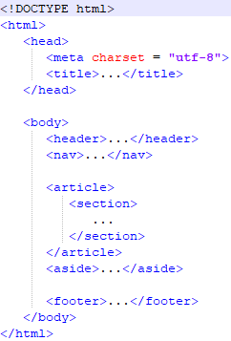
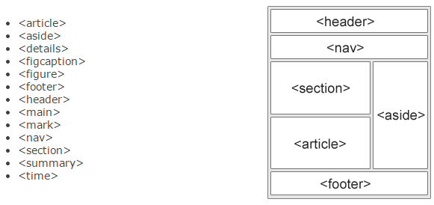
HTML5 Document
There is no concept of validation in HTML5; because HTML5 is not defined as SGML or XML application.

Slide 13
Web Forms 2.0
Web Forms 2.0 is an extension to the forms features found in HTML4. Form elements and
attributes in HTML5 provide a greater degree of semantic mark-up than HTML4 and free us from a great deal of tedious scripting and styling that was required in HTML4.

Slide 14
HTML5 − Canvas
HTML5 element <canvas> gives you an easy and powerful way to draw graphics using JavaScript.
It can be used to draw graphs, make photo compositions or do simple (and not so simple) animations.

Slide 15
Topics
HTML5
Elements, Tags, Attributes
Formatting Tags
Styles
Lists
Tables
Embedding Images
Embedding Media (Audio and Video)
HTML Elements & Layouts
Web forms
Canvas

Slide 16

First HTML program
Structure of an HTML document
Write a sample HTML program
Save and run the HTML program

Slide 17
Element, Tags and Attributes
HTML document contains a set of elements
Each element consists of some content between tags
Some elements don’t require any content - Empty Elements
We can also have Nested Elements
The contents to be structured on the web are defined by Tags
Written in between the < > (angular brackets)
Tags will have a start and an end
syntax: <tag-name> content </tag-name>
End tag contains a / (forward slash) before the tag name
Some tags don’t require an end tag <br/>
HTML Tags are not case sensitive
It is advisable to use lower-case

Slide 18
Element, Tags and Attributes
Attributes are additional information pertaining to an Element
Written inside the starting tag
Declared by name - value pair separated by = symbol
syntax: <tag-name attr-name=attr-value> content </tag-name>
Values containing spaces have to be entered within single or double quotes
<tag-name attr-name="attr value"> content </tag-name>
Multiple attributes can be specified with help of ; (semicolon) separator
<tag-name attr-name1="attr value"; attr-name2="attr value"> content </tag-name>

Slide 19
Some Common Attributes
title
href
id
class
Style
Values that contain more than one word, can be declared within single or double quotes. It is mandatory to close the quotes, else the attribute won’t be applied.

Slide 20
Formatting Tags
HTML allows us to do basic formatting of the content
Formatting tags are exactly same as in any word processor application
Headings (h1, h2, h3, h4, h5, h6)
Paragraph
Bold, Italic, Underline
Large and Small
Insert and Delete
Superscript and Subscript
Line Break
Horizontal Ruler
Anchor

Slide 21
HTML Headings
In any document, we use headings for various purposes in various sizes
HTML allows us to create headings with six different sizes
Heading tag will start from h1 for large headings and ends with h6 for smaller ones
A line space will be added automatically before and after the headings

Slide 22
Break Tags
<br/> or <br>
Break tag is a self-closing tag which doesn't require an end tag

Slide 23
Anchor Tag
In our webpage we could have many links that navigate us to either:
a section in the same page
a different page
an external website
This action can be created with the help of <a> tag
This tag is also called as hyperlink tag
Anchor tag should always be declared along with its attribute – href
href stands for hyperlink reference
The value of href holds the target link

Slide 24
Anchor Tag
Syntax: <a href="target link"> content </a>
The content within the Anchor tag is clickable
By clicking on this text, we will be redirected to the targeted link
The content can be a text or an image
[For redirecting link make sure that the specified HTML file is available in the same folder or with full path]

Slide 25
Anchor Tag - target
target is an another important attribute for the anchor tag
It species where the target has to be redirected
The values are
_blank: Opens in a new tab
_parent: Opens in the parent frame
_self: Opens in the same frame
_top: Opens in the full body of the window

Slide 26
Styles
Allows us to define the presentation of the HTML Elements
Defined in 3 ways:
Inline attribute for the tags
Individual tag
External style sheet (CSS)

Slide 27
Style Attribute
Style is an attribute that specifies the style of an element
For eg: font-family, font-size, colour, etc.
Style attribute decides how the content will be displayed
Once the style attribute is declared for a tag, it will override the existing property
Syntax: <tag-name style = "Property-Name:Value"> content </tag-name>
We can add more properties with the help of semi-colon
<tag-name style = "Property1:Value; Property2:Value"> content </tag-name>
Notes:
Open code

Slide 28
Style Tag
It defines the styles for the whole document
We can have many style tags for a single document
It has to be declared inside the head section
It has both start and an end tags
syntax: <style> tag-name { property:value; } </style>
We can add styles for multiple tags
Multiple attributes for the tags

Slide 29
Common Style Properties
background-color to set the background
style="background-color:red;"
color to set the font color
style="color:blue;"
font-family to set the font
style="font-family:courier;“
font-size to set the font text size
style="font-size:24px;"
text-align for text alignment
style="text-align:right;"

Slide 30
CSS
External styles are defined with the help of CSS
CSS - Cascading Style Sheet is a Single file, which can define the styles for multiple HTML pages
CSS file will not have any HTML code
Include the CSS file in the head section with the help of link tag
syntax: <link rel = "stylesheet" href = "filename.css">

Slide 31
Lists
Groups the related content together
Create structured navigations like menu bars
Types of List
Unordered List
Ordered List
Definition or Description List
All these types have a start and an end tag
syntax:
<type of list>
<li> list item 1 </li>
<li> list item 2 </li>
.
.
<li> list item n </li>
</type of list>

Slide 32
UL Style Types
We can use CSS and style to modify how the Unordered List should be displayed
We have to specify the style inside the start tag
<ul style = "list-style-type:style">
Disc (default)
Circle
Square
None

Slide 33
OL Types
Numbers (1, 2, 3)
Upper Case Letters (A, B, C)
Lower Case Letters (a, b, c)
Roman Numerals in Uppercase (I, II, III)
Roman Numerals in Lowercase (i, ii, iii)

Slide 34
Description List
Description List <dl> is not like the other two lists
It will display the list in the form of a name - value pair
That means it will display the line item without prefixing it with a bullet or a number
Each list item will have a name and a value to it.
Instead of li tag, we have to use dt and dd tags
dt - Term or name
dd - Term definition or value
dt and dd have a start and end tag

Slide 35
Description List
Must have at least one term and a value assigned to it
We can have multiple values for a single term
<dl>
<dt> Name 1 </dt>
<dd> value 1 </dd>
<dt> Name 2 </dt>
<dd> value 1 </dd>
<dd> value 2 </dd>
</dl>

Slide 36
Nested List
We can also have a list inside a list. This is called a Nested List
Both the lists need not be the same
For eg: Both need not be ordered or unordered or descriptive
<ol>
<li> Unit 1 </li>
<ul>
<li> Chapter 1 </li>
<li> Chapter 2 </li>
</ul>
<li> Unit 2 </li>
<ul>
<li> Chapter 1 </li>
<li> Chapter 2 </li>
</ul>
</ol>
1. Unit 1
Chapter 1
Chapter 2
2. Unit 2
Chapter 1
Chapter 2

Slide 37
Tables
Tables are used to format the content to be displayed on the web, in the form of Rows and Columns
Table Attributes
HTML attributes and styles
Border
Width
Spacing and Padding
Rowspan and Columnspan

Slide 38
Table Attributes
The Rowspan and Columnspan are declared inside the td and th tag
The others are declared inside the table start tag or in a style tag or attribute
Spacing and Padding
Border Spacing - Space between the cells
Padding - Space between the cell content and cell border

Slide 39
Comments
Helps us to understand the code
It enables us to write documentation of a program inside the code itself
Helps us to debug the code
It also helps us to skip a snippet of code without executing it
syntax: <!-- our comments -->

Slide 40
HTML Entities
In HTML some characters are reserved
The browser will consider those characters as a part of HTML syntax
We can use these reserved characters in the content in the form of HTML Entity
The name or number of the entities have to be written in between ampersand and semicolon symbols
Blank space ( ) - &nbsp;
Less than (<) - &lt;
Greater than (>) - &gt;
ampersand (&) - &amp;

Slide 41
Embedding Images
In HTML, we can embed the image as a
Normal image
Background image
Link
Single image with multiple links
syntax: <img src="image name along with the path">
Before embedding any media, always ensure that you have all the rights to use the file
Sharing files on the web without reusable permission, is illegal

Slide 42
Embedding Images
We can embed an image in any one of the following ways
From the computer
Downloading from the internet
Via a link
Common image formats supported by most web browsers are:
.jpg/.jpeg
.png
.gif
.svg

Slide 43
Image Attributes
We can also use some more attributes for the image, such as:
Align
Border
Float

Slide 44
Image Maps
Image Maps are used to mark a particular area in an image
With this we can create multiple links in a single image

Slide 45
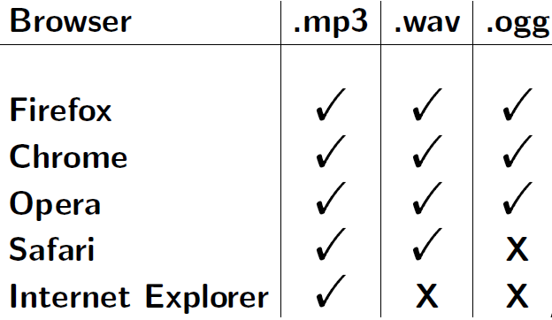
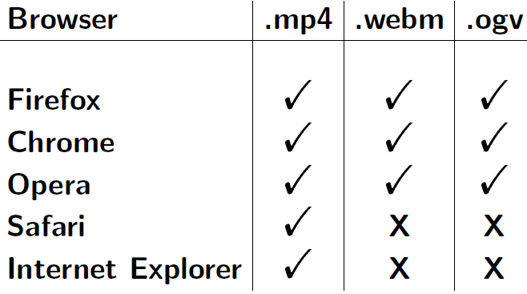
Embedding Media
We can directly embed the media using audio and video tags
Only 3 commonly used audio and video formats are allowed to be used
Web browser does not require any plugin to play those Audio/Video formats
HTML5 Audio Formats HTML5 Video formats

Slide 46
Common Media Attributes
Preload
Autoplay
Loop
Mute
Media Group
Poster (Only for video tag)
Width & height (Only for video tag)

Slide 47
HTML Elements
Block level elements
Block level elements are used to create individual blocks in the HTML document
Each block level element starts on a new line
It also creates a line break at the start and end on its own
We can create a block element inside another block element
Inline elements
Inline elements can be added anywhere in the line
It won't create any line break
They are individual tags

Slide 48
Block Level Elements
Paragraph Tag
Heading Tags
List Tags
Div Tag
Form Tag
Table Tag

Slide 49
Inline Elements
Bold, Italic, Underline
Superscript and Subscript
Emphasize, Big, Small, Strong
Insert, Delete, Code, Cite
Span

Slide 50
div tag
Division or div tag is a block level tag
With the help of div tag and CSS, we can create:
Groups for a set of data presentation and
Web layouts
We can create the same look using Table tag also
But that is not a good practice for creating blocks or layouts
Creating a block or layout using div tag is more easy and flexible
But it requires lot of practice to become an expert in div tag for creating good layouts

Slide 51
span tags
Span tag can be
Used to group the inline elements
Used to set different styles for a particular section
Inserted anywhere inside any tag

Slide 52
HTML5 Layouts
In HTML5 we can also create layouts without the div tag
For each part of the webpage, we have the layout elements
<header> - Page headers
<nav> - Navigations or Links
<section> - Document sections
<article> - Articles
<aside> - Sidebar contents
<footer> - Page footer

Slide 53
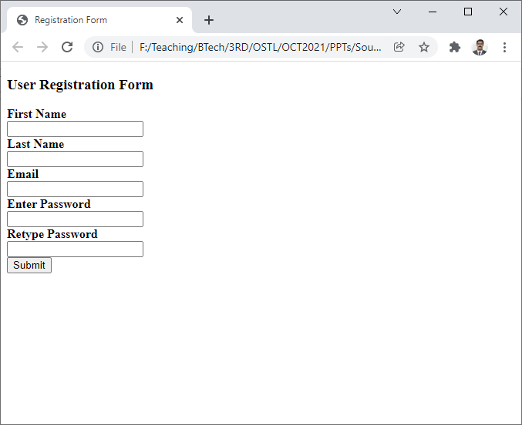
Web Forms
Forms are generally used to collect some information from the user
It can be a
Registration Form
Login Form
Survey
Billing Form

Slide 54
Form Elements
Label
Input
Text Area
Select
Datalist
Output
Fieldset
Button

Slide 55
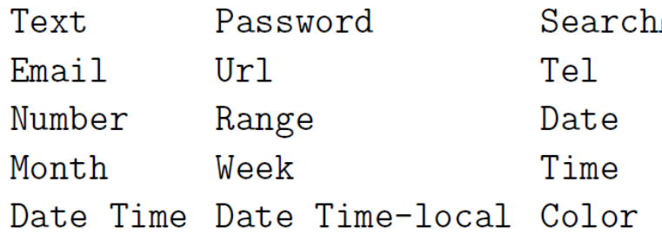
Input Types
We can use any one of the following input types based on our requirement

Slide 56
Button Element
Button element is used to perform an action when the button is clicked
For eg:
store the input data to the database
send the form values to another page or script, to perform another action
display some message on the same page

Slide 57
Date/Time Input type
Date
Month
Week
Time
Date Time
Date Time-local

Slide 58
Form Methods
Form method will be used when we are working with
Interactive web pages
Client-server mechanism
Two methods
GET
POST

Slide 59
GET Method
GET method will pass the values via URL
Passed values will be seen in the URL
syntax: <form action="form2.html“ method="get">
action attribute defines the place to which the values have to be passed

Slide 60
POST Method
POST method will pass the values via HTTP request
Passed values will not be seen in the URL
It is advisable to use POST method for secure transactions like login and money transactions
syntax: <form action="form2.html“ method="post">
action attribute denes the place to which the values have to be passed

Slide 61
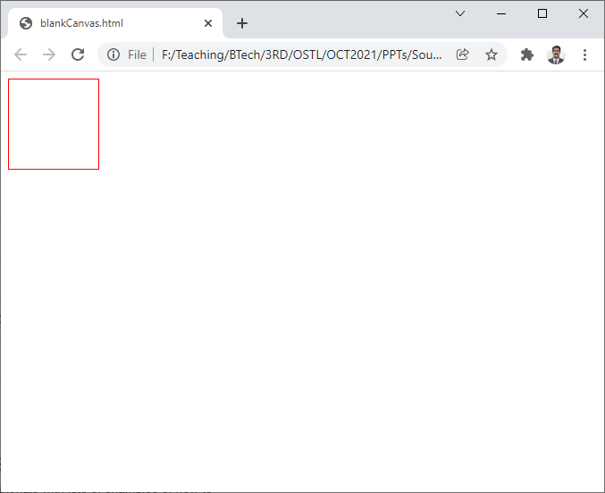
HTML Canvas
HTML5 element <canvas> gives you an easy and powerful way to draw graphics using JavaScript. It can be used to draw graphs, make photo compositions or do simple (and not so simple) animations.
Here is a simple <canvas> element which has only two specific attributes width and height plus all the core HTML5 attributes like id, name and class, etc.
<canvas id="mycanvas" width="100" height="100"></canvas>

Slide 62
Rendering Context
The <canvas> is initially blank, and to display something, a script first needs to access the rendering context and draw on it.
The canvas element has a DOM method called getContext, used to obtain the rendering context and its drawing functions. This function takes one parameter, the type of context 2d.
After creating the rectangular canvas area, you must add a Script to do the drawing.

Slide 63
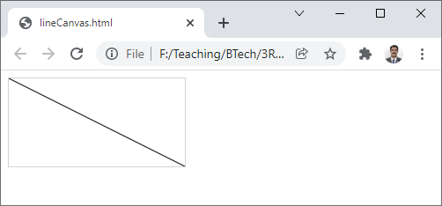
Draw a line
<!DOCTYPE html>
<html> <body>
<canvas id="myCanvas" width="200" height="100" style="border:1px solid #d3d3d3;">
Your browser does not support the HTML canvas tag.</canvas>
<script>
var c = document.getElementById("myCanvas");
var ctx = c.getContext("2d");
ctx.moveTo(0,0);
ctx.lineTo(200,100);
ctx.stroke();
</script>
</body> </html>

Slide 64
What to do now …
https://www.w3schools.com/
https://www.tutorialspoint.com/html5/
…
…
…
…

Slide 65
Thank
you ☺

